Slide 1
Hyperferritinemia approach
Alireza Rajaei MD
Rheumatology department
Loghman hospital

Slide 2
Key Recommendations
This guideline is directed to primary care practitioners who encounter an unexplained finding of high ferritin in an adult outpatient aged >19 years.
The guideline is not for screening for iron overload.
Hemochromatosis caused by mutations in iron-related genes other than HFE is outside the scope of this guideline. HFE (high Fe) is the gene most commonly associated with hemochromatosis. Because the non-HFE hereditary hemochromatosis causes of hyperferritinemia are so diverse, their management is out of scope. They should be managed according to the underlying condition.

Slide 3
Ferritin is an acute phase reactant released by activated macrophages and damaged hepatocytes.
High ferritin levels are most commonly caused by
inflammation,
infection,
liver disease (particularly non-alcoholic steatohepatitis (NASH)/fatty liver),
renal disease,
alcohol excess,
metabolic syndrome or
malignancy.
In these cases, a high ferritin level does not accurately reflect iron stores

Slide 4
The first-line investigations for a patient with a raised serum ferritin are:
History taking: alcohol intake and other risk factors for liver disease, type 2 diabetes mellitus, obesity, hypertension, symptoms and signs of an underlying inflammatory or malignant disorder, transfusion history, and family history of iron overload.
Lab tests: repeat serum ferritin, transferrin saturation (TSAT), complete blood count, serum creatinine, liver enzymes (ALT and GGT) with consideration of viral hepatitis screening and abdominal ultrasonography (if suspected liver disease or elevated liver enzymes). Check blood glucose and lipid studies if not recently performed.
Hereditary hemochromatosis is an uncommon cause of hyperferritinemia and testing for HFE-HH is not recommended in patients of non-European ancestry because its prevalence is very rare.
Individuals of East Asian descent have ferritin values 1.5-2x higher than the upper limit of normal reported.
Iron overload can generally be excluded when TSAT <45%.

Slide 5
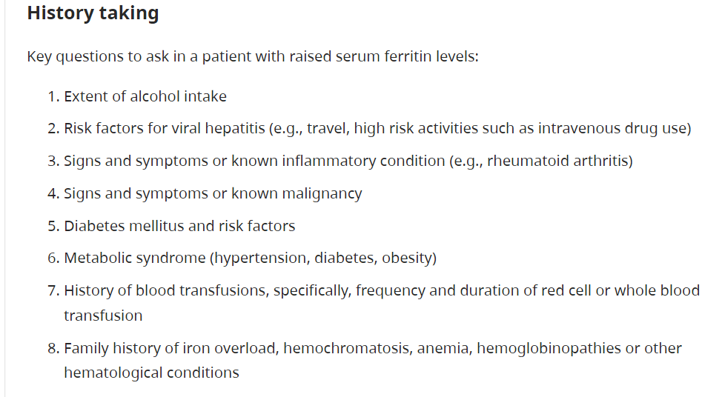

Slide 6
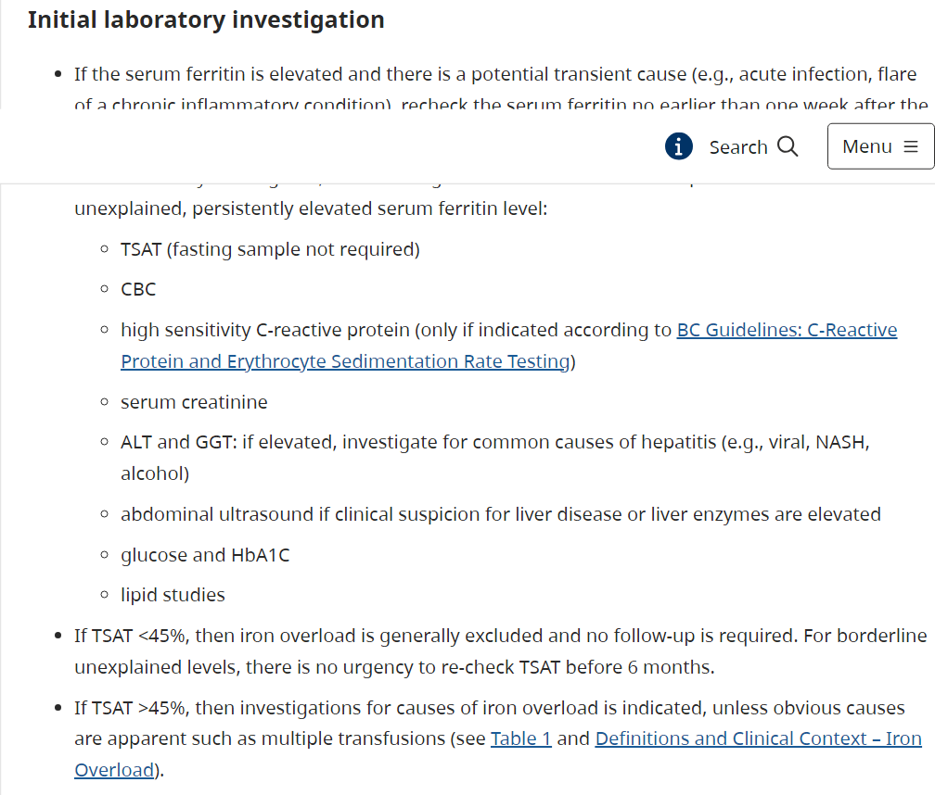

Slide 7
Definitions and Clinical context
Hyperferritinemia: occurs when a patient’s serum ferritin is above the upper reference interval. The upper reference interval varies with age, gender, and laboratory method. Individuals of East Asian descent have ferritin values 1.5-2x higher than the reference norms reported.High ferritin alone does not indicate iron overload.
Iron overload: occurs when iron absorption exceeds physiological requirements, leading to excess stores because there is a limited physiological capacity (i.e., blood loss) to get rid of excess iron. This is indicated by TSAT >45% and can occur from:
Transfusion-dependent anemias (e.g., myelodysplastic syndromes (MDS), sickle cell anemia)
Anemia from ineffective erythropoiesis (e.g., thalassemia, MDS)
Chronic excessive ingestion of medicinal iron
Hereditary hemochromatosis (HH)

Slide 8
HFE-associated Hereditary Hemochromatosis (HFE-HH): is an autosomal recessive genetic disorder common in individuals of European ancestry, in which an increase in the intestinal absorption of iron leads to excessive iron deposits in organs such as liver, pancreas, heart, pituitary, testicles, joints, and skin. Early detection and treatment can completely prevent clinical sequelae, and, in symptomatic patients, phlebotomy effectively reduces morbidity and mortality.
HFE-HH has a relatively low clinical penetrance, with fewer than 10% of those homozygous for the C282Y variant (the most common mutation) developing clinical manifestations, which usually present by age 40-50 in men and age 50-60 in women. Liver impairment is the most common presentation. Nonspecific symptoms such as arthralgias, fatigue, and abdominal pain may be noted years before organ dysfunction becomes apparent. If untreated, iron overload can cause serious organ damage and premature death but end-organ damage is rare with a ferritin value < 600 μg/L.
Over 80% of HFE-HH is due to homozygous mutation for C282Y in the HFE gene. Hemochromatosis caused by mutations in other iron-related genes are rare and are outside the scope of this guideline. Suspected cases should be referred to a specialist.

Slide 9
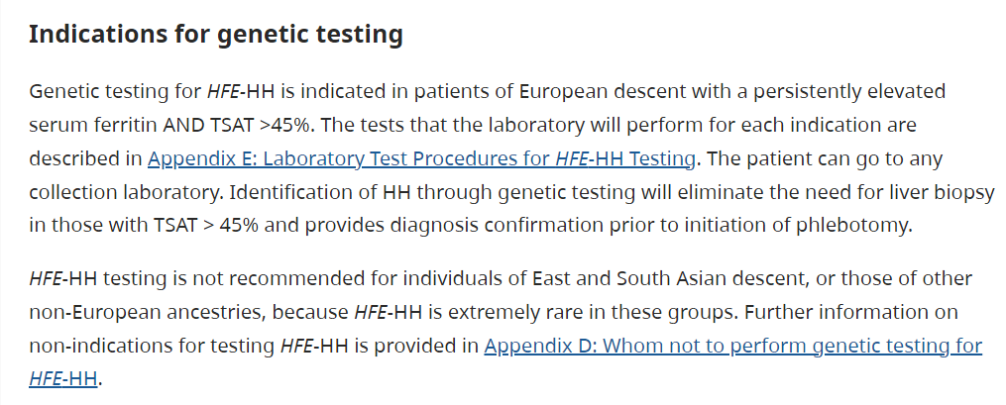

Slide 10
Signs and Symptoms
Signs and symptoms of high ferritin levels
The signs and symptoms of high ferritin are due to the underlying conditions (e.g., infection) and not due to the high ferritin in and of itself.
Signs and symptoms of iron overload
Iron overload is often missed because its symptoms are nonspecific and gradual multiorgan damage occurs over many years. Its symptoms can mimic those of much more common diseases, such as alcoholic liver disease, diabetes, and osteoarthritis.
Nonspecific symptoms of extreme iron overload are provided .Nonspecific signs and symptoms of extreme iron overload by organ. Iron overload does not cause a high hemoglobin.

Slide 11
Diagnosis
Differential diagnosis of high ferritin
This may include inflammatory disorders, liver disease (particularly non-alcoholic steatohepatitis (NASH)/fatty liver), alcohol excess, malignancy, renal failure, and metabolic syndrome, which are each more common than hemochromatosis. Fatty liver is a very common cause of high ferritin in out-patients.
Extreme hyperferritinemia >3000 µg/L can be seen in transfusional iron overload, severe liver disease, hemophagocytic syndromes, renal failure, sepsis, severe inflammation and other severe illnesses, typically in a hospital setting.
In patients with serum ferritin levels >10,000 µg/L, acute hepatitis and rare conditions such as adult onset Still disease, hemophagocytic lymphohistiocytosis and hematological malignancies should be considered.

Slide 12
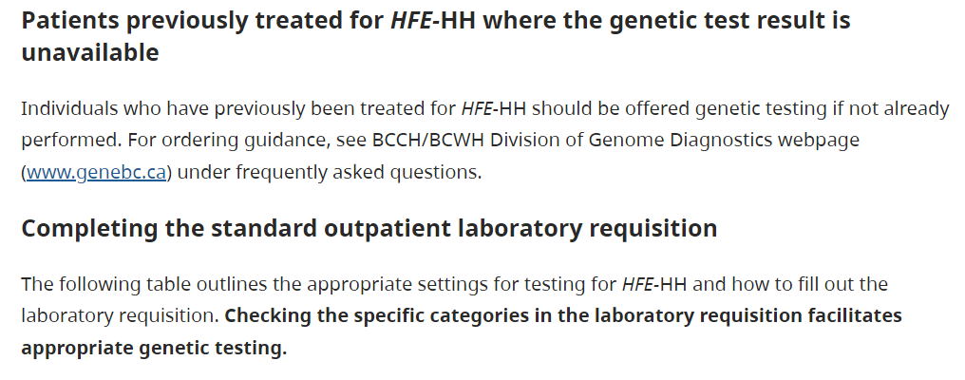

Slide 13
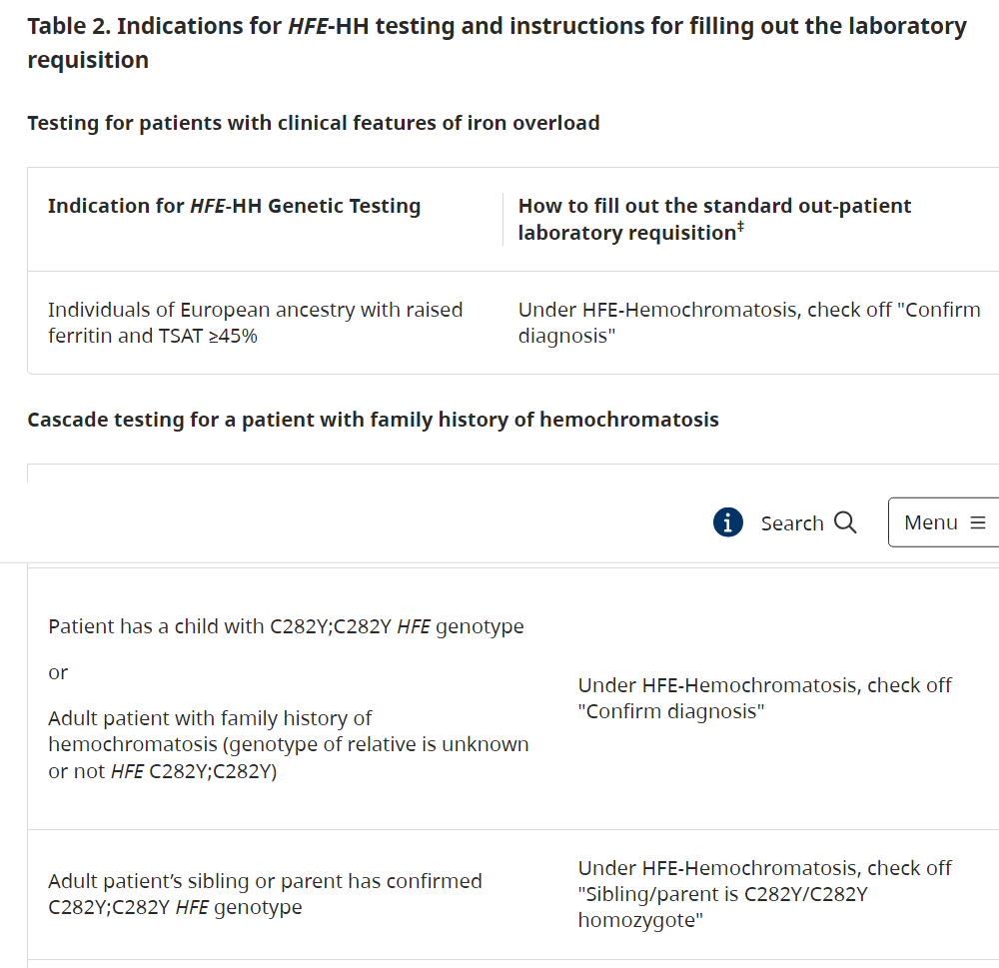

Slide 14
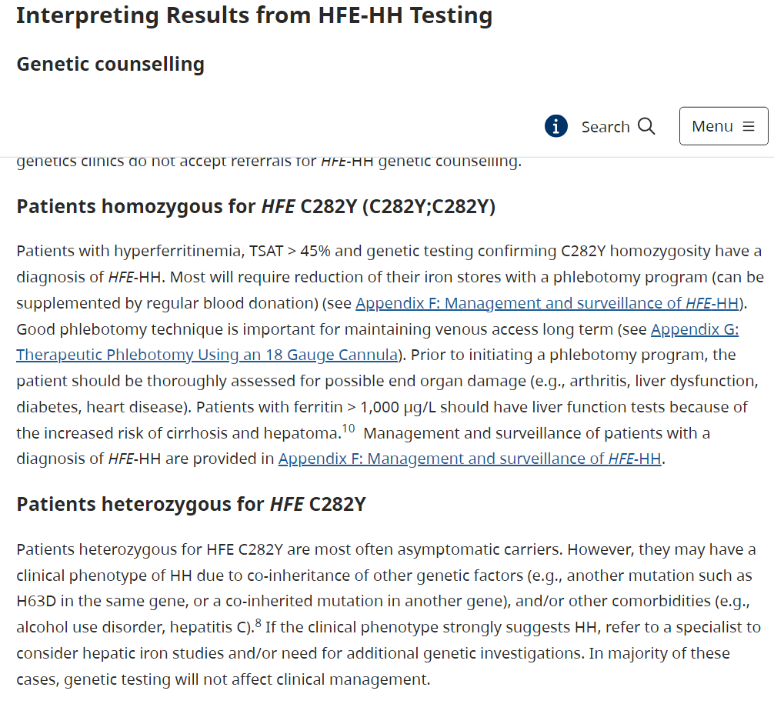

Slide 16
